Slide 1



Pima Community College ASCEND Flight: Spring 2010
A post-mortem!!!

Slide 2
Payload Mission
This is the first payload design for 4 new team members.
Our goal was to build a basic payload that would be capable of taking full motion video of the entire flight.
Additional instrumentation on-board is a HOBO Micro Station Logger with temperature and pressure sensors.
We have built a resistance heater to aid in keeping the camera warm**.
** an earlier flight by another experimenter was successfully done without heating!!!

Slide 3
Flight Results
Flip-Video camera was a success. Complete flight was recorded.
Temperature data successfully recorded.
Pressure sensor failed.
Payload suffered damage immediately after burst.

Slide 4
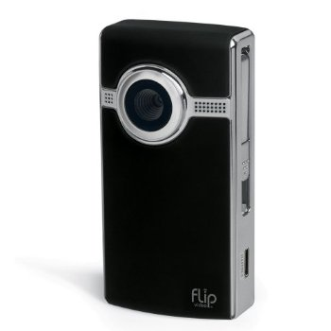
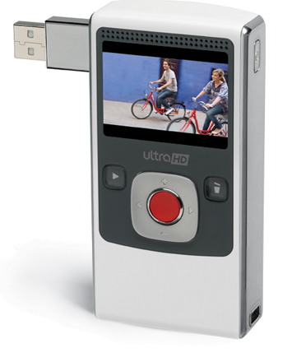
Flip Video Recorder 120 min. Ultra HD
Weight: 149 gm.
Resolution: 1280 x 720 p
Frame Rate: 30 fps
Video Bit rate: 9.0 Mbps
File Format: Saves as MP4
Run Time: 2 hr
Internal Memory: 8GB
Zoom: 2x digital
Battery Life: up to 6.5 hr (with AA Lithium)

Slide 5
Flight Data

Slide 6
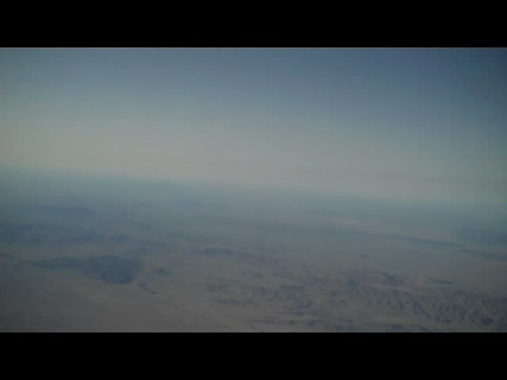
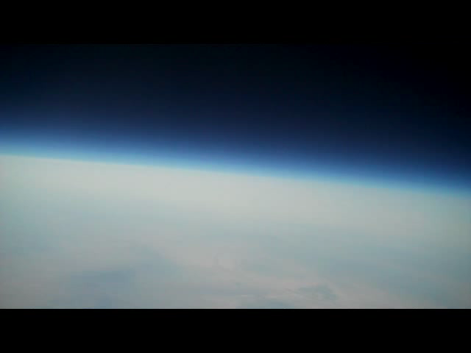
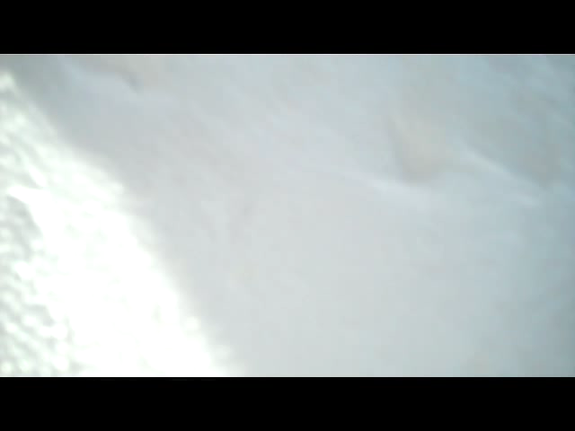
Video Clips
Just After Take off
Burst (~ 86,000 ft.)
Chaos after burst
Landing

Slide 7
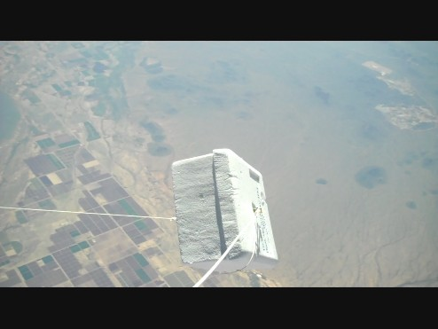
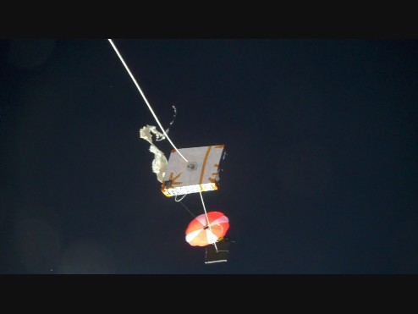
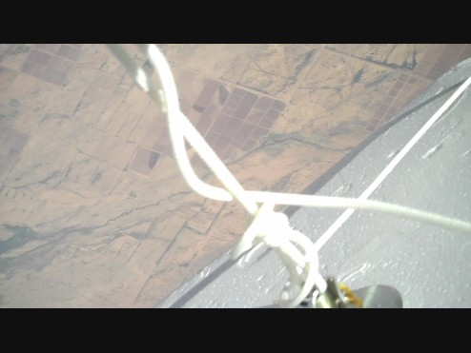
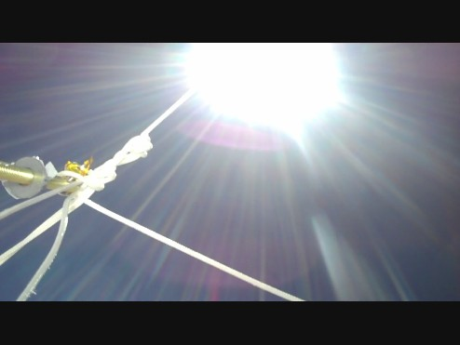
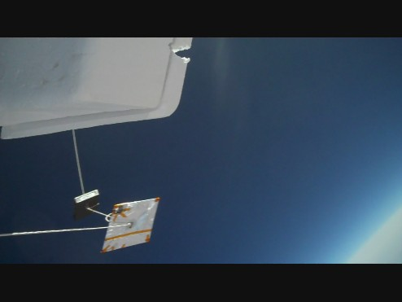
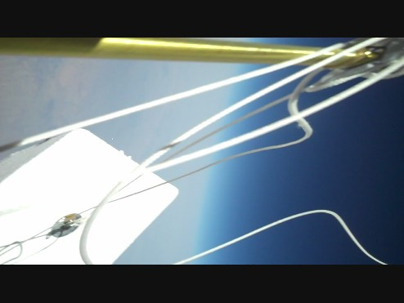
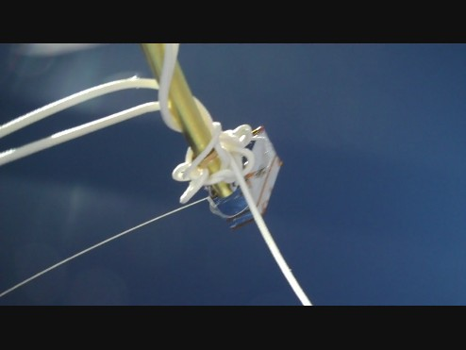
Photographs from Flight
Notes:
You’ll need to know the altitude and time for each of these pics..

Slide 8
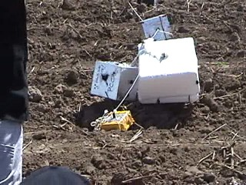
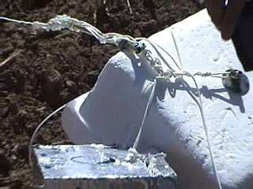
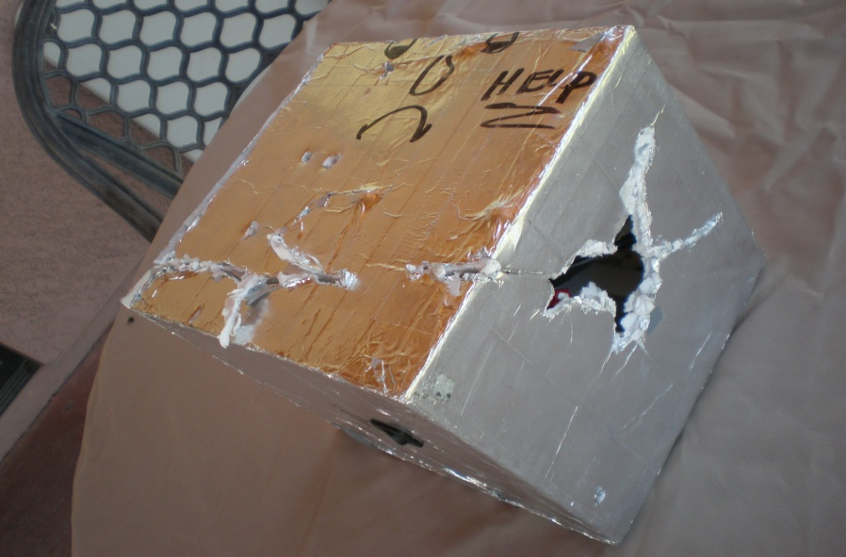
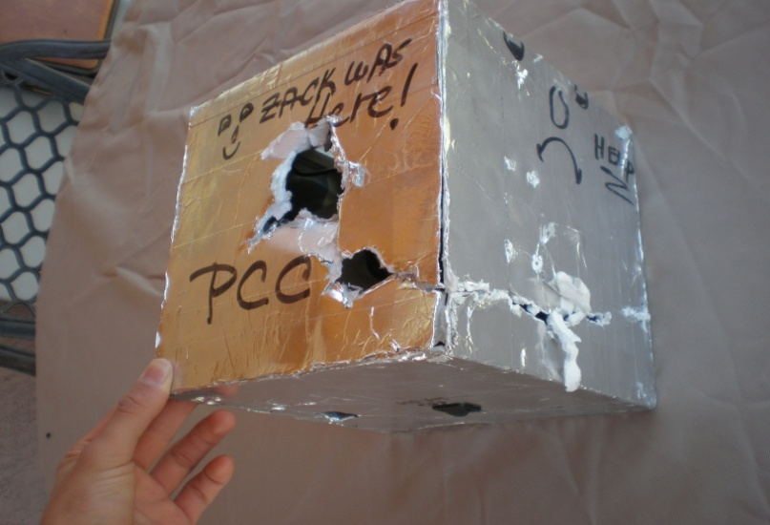
Payload Damage

Slide 9
Conclusions
We’re still not sure what caused the lamp rod to be pulled out of its mount.
Previous payloads using the same lamp rod mounting scheme did NOT fail!
The camera and it’s mount remained intact!
Further review of the video may give us a clue when coupled with altitude data, terminal velocity calculations and force calculations.

Slide 10
Acknowledgements
We would like to thank the following people and organizations for their help with our first payload design and balloon launch:
  Amy Gladwin
  Peter Kozak
  Stacy Harrison
  ASCEND
  Arizona Space Grant Program

Slide 11
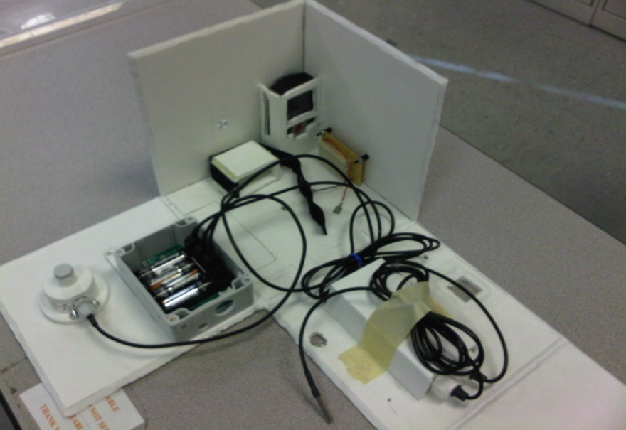
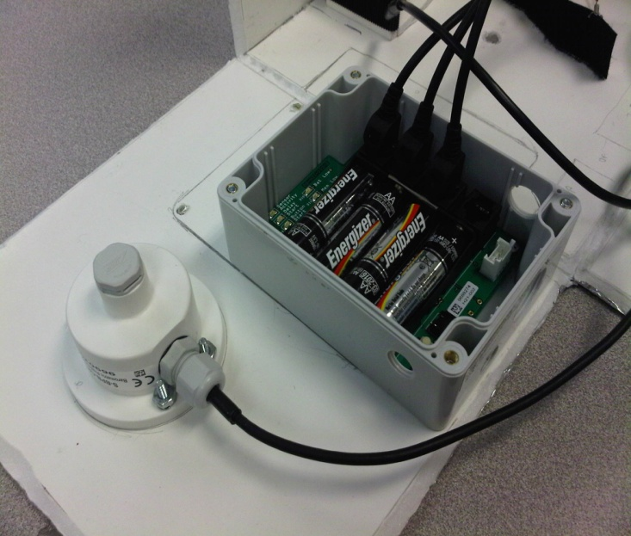
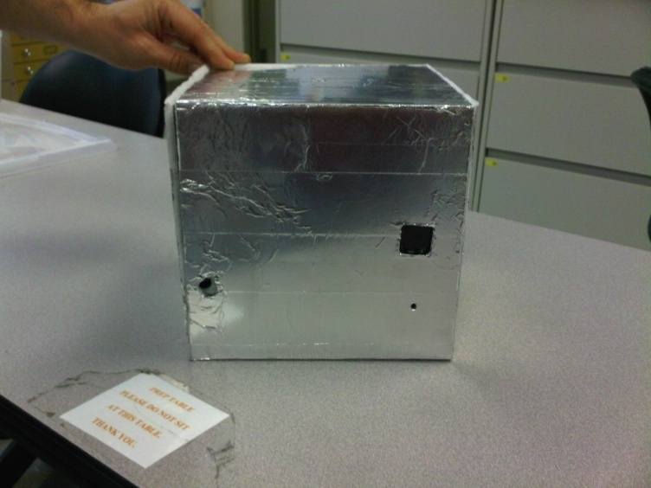
PCC Payload Spring 2010

